Slide 1


SMART INDIA HACKATHON 2024
TITLE PAGE
Problem Statement ID –SIH1594
Problem Statement Title-Student Innovation
Theme-Transportation and Logistics
PS Category- Software
Team ID-
Team Name-Park Lordz

Slide 2

ONLINE APPLICATION FOR PARKING SLOT REGISTRATION
Park Lordz
To develop an online application for parking slot registration
To make parking more compatible by providing information about the parking slots availability
Making our application more user friendly by adding the features like wake up call before 15 mins of booking time and providing slot’s live route in the tickets which will be in QR form
‹#›

Slide 3



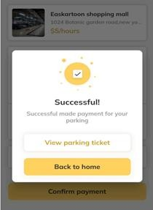

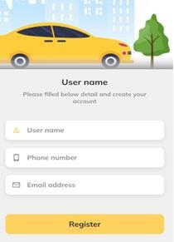
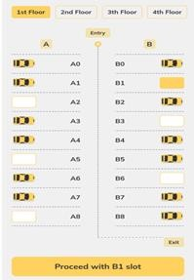
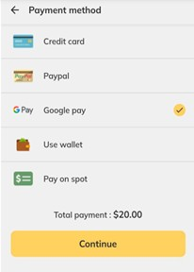









TECHNICAL APPROACH
Park Lordz
Programming Language – Dart , Framework - Flutter
Methodology – It is working in the basis of Transportation
Management System
System Flow
Login
& verification
Prototype modules
Verification Booking Confirmation
Search availability & status
Prior arrangement & payment
Vehicles details & surveillance
Confirmation tickets

Slide 4
FEASIBILITY AND VIABILITY
Park Lordz
Live surveillance of the parking vehicles through manpower and cloud storage of the users for enabling cookies and booking history
The challenges of implementing surveillance system and cloud may resulting the additional cost efficiency
This can be rectified by made the subscription system and cost can be collected as monthly or yearly
Users of this application can also utilize fasttag recharging for their booking references at the entry plot, which facilities easier information validation

Slide 5
IMPACT AND BENEFITS
Park Lordz
IMPACTS:
• Eliminate parking related stresses and property damage from non parking disasters caused by ignorance of parking slots availability, especially for our intended audience(Individuals who require parking slots)
BENEFITS:
• By making it simpler to locate parking spaces, this application gives users a worry free driving experience while also saving time.
• This leads an effortless secured payment and also decreased traffic congestion and fuel energy savings.

Slide 6


RESEARCH AND REFERENCES
Park Lordz
Automatic Car Parking System using PLC
https://doi.org/10.17577/ijertv9is060193
Design and Implementation of an Android Smart Parking Mobile Application
https://doi.org/10.18421/tem94-06
Earn money through by your parking space
Parkify | Parking near me

